Slide 1
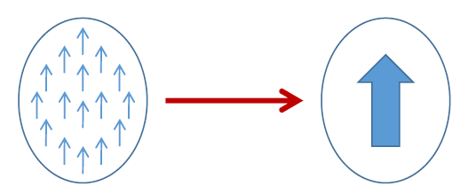
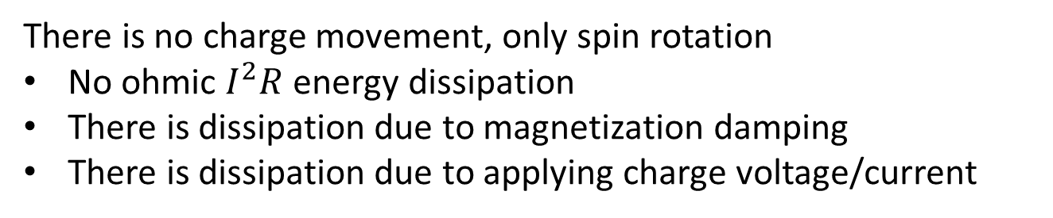
Spintronics: Spin-Electronics
Spin
Spin
Spin Up (↑) / Down (↓)
0 / 1
Charge
A rapidly developing nanotechnology
Spintronic devices are non-volatile and endurable
Advantage over transistors (requires extra circuitry )
Electron
Along with charge, electrons have spin
There is no charge movement, only spin rotation
No ohmic $I^{2}R$ energy dissipation
There is dissipation due to magnetization damping
There is dissipation due to applying charge voltage/current
Electron beam lithography (EBL)

Slide 2
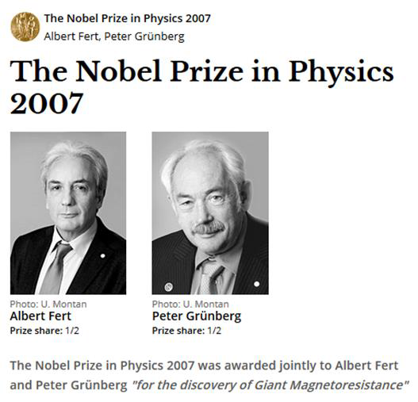

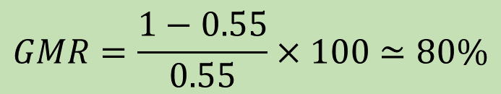
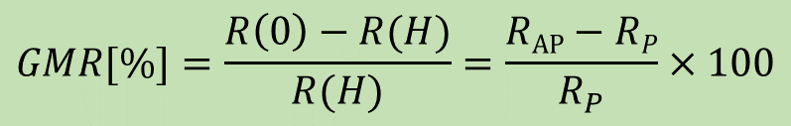


Giant Magneto-Resistance (GMR)
Giant Magneto-Resistance (GMR)
$$GMR=\frac{1−0.55}{0.55}×100≃80\%$$
$$\text{Fe}$$
$$\text{Cr}$$
$$\text{Fe}$$
1988
A. Fert, M.N Baibich et al., Phys. Rev. Lett. 61, 2472 (1988)
P. Grunberg, G. Binash et al., Phys. Rev. B 39, 4828 (1989)
$$GMR[\%]=\frac{R\left(0\right)−R(H)}{R(H)}=\frac{RAP−RP}{R_{P}}×100$$
Notes:
Magneto resistance: With the effect of magnetic field, how resistance get changed.

Slide 3
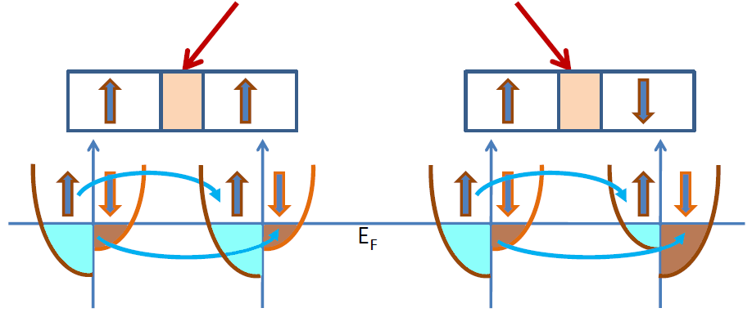






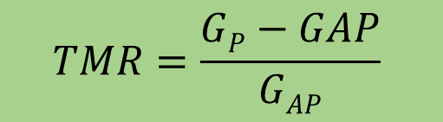

Tunneling magneto-resistance (TMR)
Insulator
e.g., Al₂O₃, MgO
Conductance is proportional to the density of states
N_{L}↑, N_{R}↑, N_{L}↓, N_{R}↓
Left (L)
Right (R)
Left (L)
Right (R)
$$G^{↑↑}∝N_{L}^{↑}{ N}_{R}^{↑}$$
$$G^{↓↓}∝N_{L}^{↓}{ N}_{R}^{↓}$$
$$G^{↓↑}∝N_{L}^{↓}{ N}_{R}^{↑}$$
$$G^{↑↓}∝N_{L}^{↑}{ N}_{R}^{↓}$$
$$EF$$
$$TMR=\frac{GP−GAP}{GAP}$$
Reported 1975 (prior to GMR)
TMR>500% using MgO spacer
$${GP=G}^{↑↑}+ G^{↓↓}$$
$${GAP=G}^{↓↑}+G^{↑↓}$$
Julliere, M. Tunneling between ferromagnetic film. Phys. Lett. A 54, 225-226 (1975)
Moodera, J. S. et al., Phys. Rev. Lett. 74, 3273 (1995)
Mathon, J. et al., Phys. Rev. B 63, 220403 (2001), Butler, W. et al., Phys. Rev. B 63, 054416 (2001)
Yuasa, S. et al., Nature Mater. 3, 868 (2004), Parkin, S. et al., Nature Mater. 3, 862-867 (2004)

Slide 4
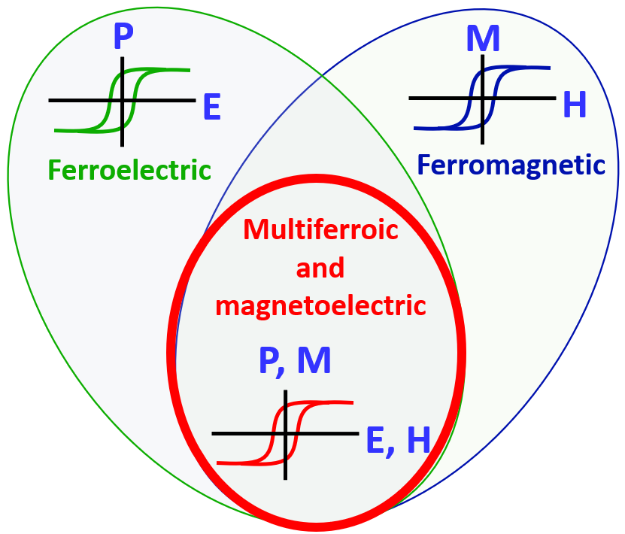
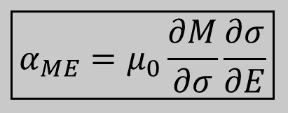
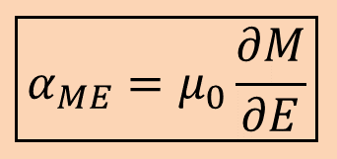


Multiferroics and Multiferroic Composites
Multiferroic
Magnetostrictive
Piezoelectric
Strain
E
E
Piezoelectricity
Magnetoelectricity (intrinsic)
Piezoelectricity
Magnetoelectricity (intrinsic)
P
P
$$ε$$
M
$$ε$$
M
$$σ$$
H
$$σ$$
H
Magnetostriction
Magnetostriction
$$\boxed{α_{ME}=μ_{0}\frac{∂M}{∂E}}$$
$$\boxed{α_{ME}=μ_{0}\frac{∂M}{∂σ}\frac{∂σ}{∂E}}$$
Notes:
Change it to multiferroic composites

Slide 5
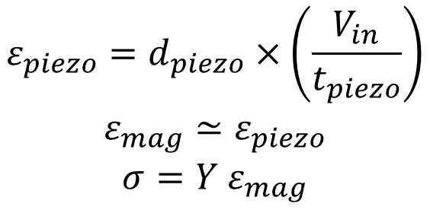
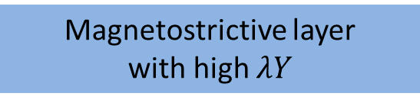
Multiferroic composites Voltage vs stress anisotropy
V_{in}
t_{mag}
Magnetostrictive
$$ε_{piezo}=d_{piezo}×\left(\frac{V_{in}}{t_{piezo}}\right)$$
$$ε_{mag}≃ε_{piezo}$$
$$σ=Y ε_{mag}$$
Piezoelectric
t_{piezo}
x (1)
y (2)
z (3)
Choose piezoelectric layer with high de-coefficient
strain transfer
Y: Young’s modulus
Magnetostrictive layer
with high $λY$

